Slide 2
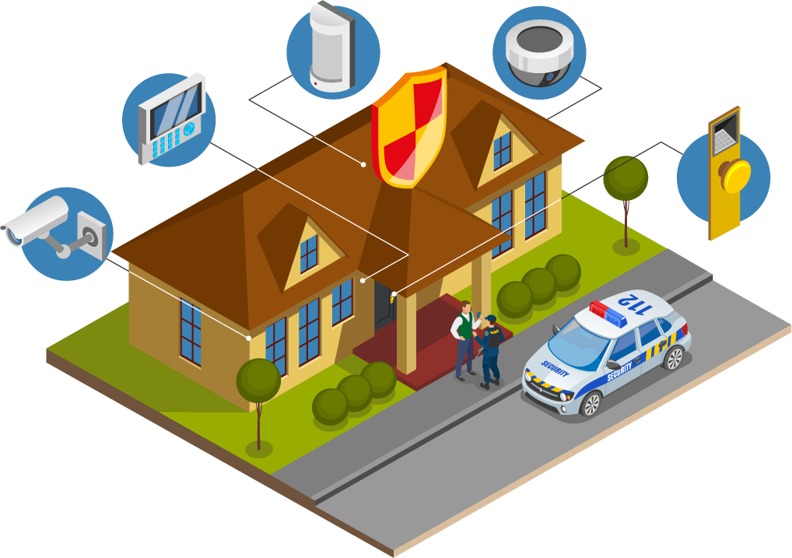

System Analysis And Design
Residential Security
Monitoring System
Presentation
UNIVERSITY OF ASIA PACIFIC
Department Of CSE Course Code: 306

Slide 3
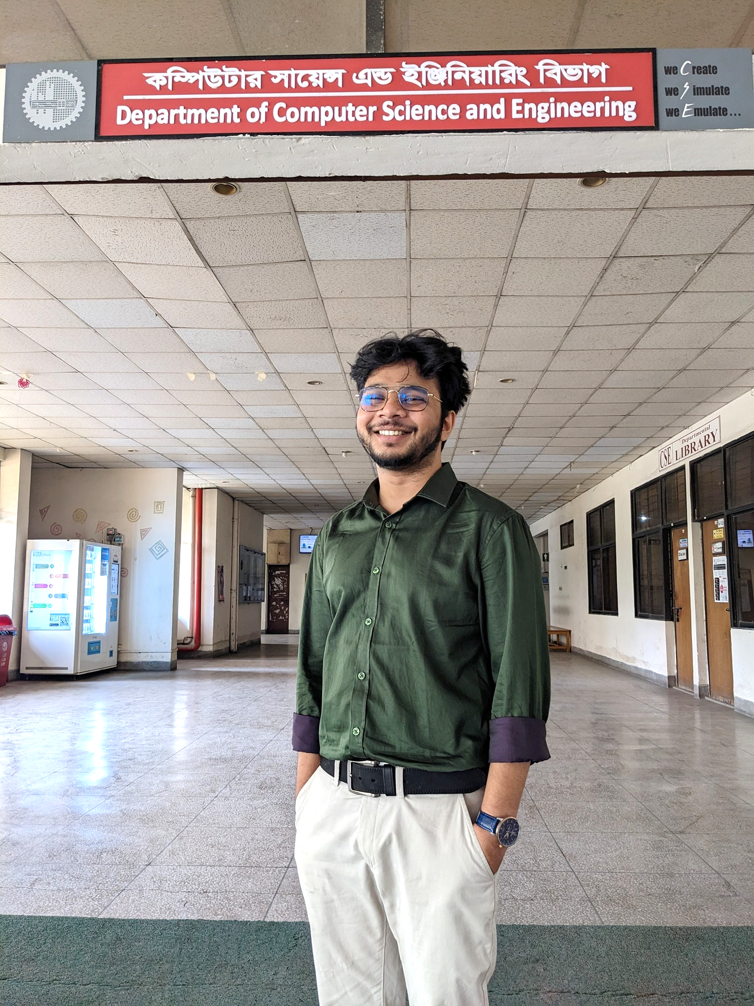


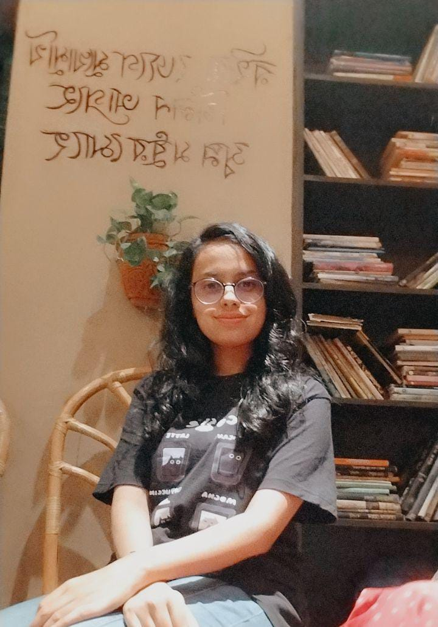

Instructor
Muhtasim Noor Alif
Team Members
Maria Akter Khushi
21201107
Ritu Rani Banik
21201108
Jannatul Ferdousi
21201114
Nur Habibah Binte Mahbub
21201103

Slide 4


Contents:
1
Entity Relationship-Diagram
(ERD)
2
Data Flow Diagram
(DFD)

Slide 7









Data Flow Diagram (DFD)

Slide 8
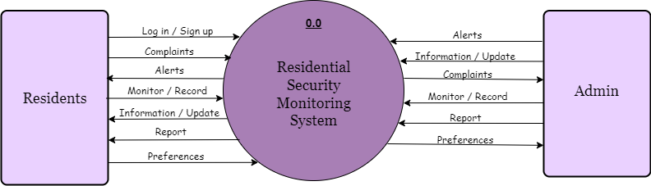
Level 0 Diagram:

Slide 9
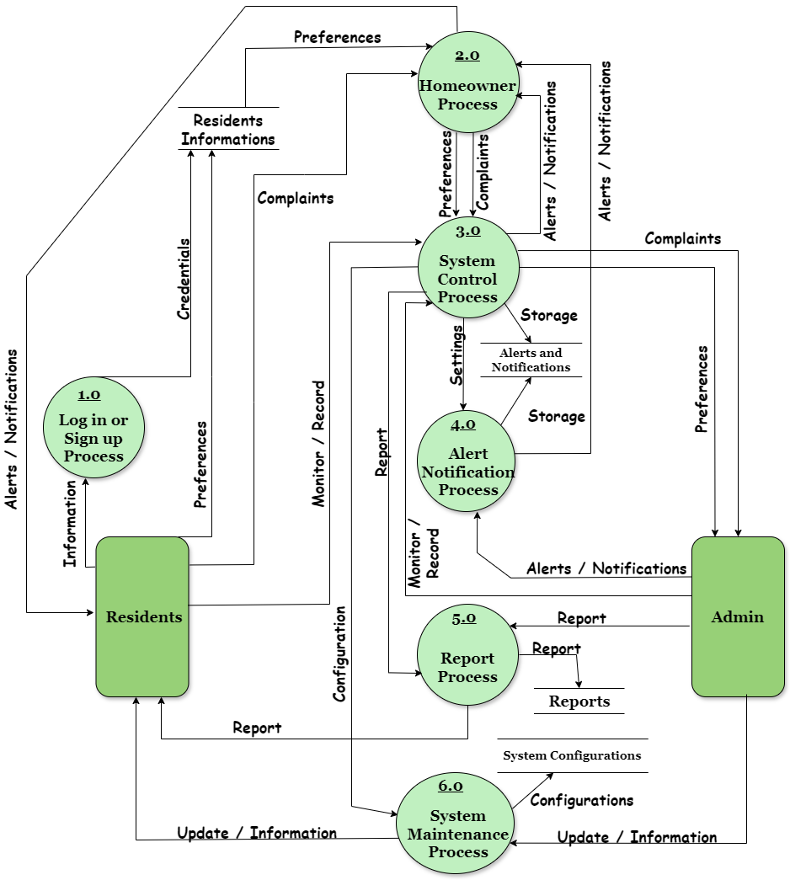
Level 1 Diagram:

Slide 10

Thank You Everyone!

